Slide 1
CSE302-Software Quality Engineering Costs of Software Quality
Instructor: Sobia Usman
Assistant Professor
CS - CUI, LHR

Slide 2
Cost of Quality
More and more, management – whether of commercial companies or public organizations – is requiring economic evaluation of their quality assurance systems.
Cost of Quality- The economic assessment of software quality development and maintenance
Another class of software quality metrics, where financial values are used as the measuring tool
It includes all costs in performing quality related activities.

Slide 3
Cost of Quality
Quality metrics and costs of quality both support
management control and decision making.
Costs of quality is a metric displaying a unique characteristic.
Application of common financial measures enables management to obtain the type of general overview of all software quality assurance activities unavailable with any other metrics.

Slide 4
Cost of software quality metrics – objectives
Application of cost of software quality metrics enables management to achieve economic control over SQA activities and outcomes. The specific objectives are:
■ Control organization-initiated costs to prevent and detect software errors
■ Evaluation of the economic damages of software failures as a basis for revising the SQA budget
■ Evaluation of plans to increase or decrease SQA activities or to invest in a new or updated SQA infrastructure on the basis of past economic performance

Slide 5
Classic Model of Cost of Software Quality
The classic quality cost model, developed in the early 1950s by Feigenbaum
Provides a methodology for classifying the costs associated with product quality assurance from an economic point of view
Developed to suit the quality situations found in manufacturing organizations, the model has since been widely implemented.

Slide 6
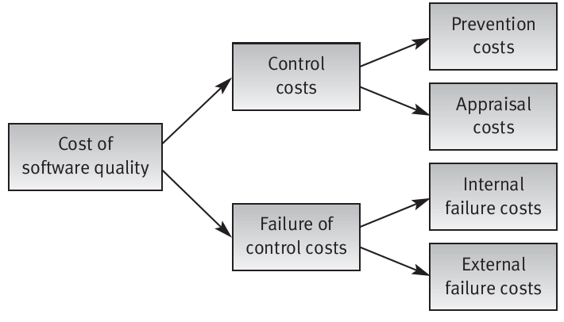
Classic Model of Cost of Software Quality

Slide 7
Classic model of cost of software Quality
The model classifies costs related to product quality into two general classes:
Costs of control include costs that are spent to prevent and detect software errors in order to reduce them to an accepted level.
Costs of failure of control include costs of failures that occurred because of failure to prevent and detect software errors
The model further subdivides into subclasses.

Slide 8
Classic Model of Cost of Software Quality
Costs of control are assigned to either the prevention or the appraisal costs subclass:
Prevention costs include investments in quality infrastructure and quality activities that are not directed to a specific project or system, being general to the organization.
Appraisal costs include the costs of activities performed for a specific project or software system for the purpose of preventing or detecting software errors

Slide 9
Classic Model of Cost of Software Quality
Failures of control costs are further classified into internal failure costs and external failure costs:
Internal failure costs include costs of correcting errors that have been detected by design reviews, software tests and acceptance tests (carried out by the customer) and completed before the software is installed at customer sites.
External failure costs include all costs of correcting failures detected by customers or the maintenance team after the software system has been installed.

Slide 10
Prevention Cost
Investments in development of new or improved SQA infrastructure components or, alternatively, regular updating of those components:
Procedures and work instructions
Support devices: templates, checklists, etc.
Software configuration management system
Software quality metrics
Regular implementation of SQA preventive activities:
Instruction of new employees in SQA subjects and procedures related to their positions
Instruction of employees in new and updated SQA subjects and procedures

Slide 11
Prevention Cost
Certification of employees for positions that require special certification
Consultations on SQA issues provided to team leaders and others.
Control of the SQA system through performance of:
Internal quality reviews
External quality audits by customers and SQA system certification organizations
Management quality reviews.

Slide 12
Appraisal Cost
Appraisal costs are devoted to detection of software errors in specific projects or software systems. Typical appraisal costs cover:
Reviews:
Formal design reviews (DRs)
Peer reviews (inspections and walkthroughs)
Expert reviews.

Slide 13
Appraisal Cost
Costs of software testing:
Unit tests
Integration tests
Software system tests
Acceptance tests (participation in tests carried out by the customer).
Costs of assuring quality of external participants, primarily by means of design reviews and software testing. These activities are applied to the activities performed by:
Subcontractors
Suppliers of COTS software systems and reusable software modules
The customer as a participant in performing the project.

Slide 14
Internal Failure Costs
Internal failure costs are those incurred when correcting errors that have been detected by design reviews, software tests and acceptance tests performed before the software has been installed at customer sites
Typical costs of internal failures are:
Costs of redesign or design corrections subsequent to design review and test findings
Costs of re-programming or correcting programs in response to test findings
Costs of repeated design review and re-testing (regression tests)

Slide 15
Internal Failure Costs
The costs of regular design reviews and software tests are considered appraisal costs.
Any repeated design reviews or software tests directly resulting from poor design and inferior code quality are considered internal failure costs.
It should be noted that corrections and changes resulting from team leader checks or other team-initiated reviews are generally not considered internal failure costs because they are conducted informally.

Slide 16
External Failure Costs
External failure costs entail the costs of correcting failures detected by customers or maintenance teams after the software system has been installed at customer sites
Typical external failure costs cover:
Resolve customer complaints during the warranty period. In most cases, this involves a review of the complaint and transmission of instructions. In most cases, complaints result from failure of the “help” function or the guidelines found in the instruction manual.
Reimbursement of customer’s purchase costs, including handling, in case of total dissatisfaction (relates to COTS software packages as well as to custom-made software).

Slide 17
External Failure Costs
Correction of software bugs detected during regular operation. Those involving correction of code (including tests of the corrected software) followed by installation of the corrected code or replacement of the erroneous version by the correct version are often performed at the customer’s site.
Correction of software failures after the warranty period is over even if the correction is not covered by the warranty.
Damages paid to customers in case of a severe software failure detected
Insurance against customer’s claims in case of severe software failure

Slide 18
The listed items reflect only overt external failure costs, costs that represent a small proportion of the full range of external failure costs.
These costs are directly incurred by software failures detected and recorded during regular operation of the software.
The greater proportion of external failure costs –hidden costs – reflect the indirect damages suffered by the software development organization as a result of those same failures.

Slide 19
External Failure Costs
Typical examples of hidden external failure costs are:
Damages of reduction of sales to customers suffering from high rates of software failures
Severe reduction of sales motivated by the firm’s damaged reputation
Increased investment in sales promotion to counter the effects of past software failures
Reduced prospects to win a tender or, alternatively, the need to underprice to prevent competitors from winning tenders.

Slide 20
Example

Slide 21
Extended Model for Cost of Software Quality
Analysis of the software quality costs
Damages paid to customers as compensation for late completion of the project due to unrealistic scheduling
Damages paid to customers in compensation for late completion of the project as a result of failure to recruit sufficient staff
Management can perform several activities to prevent or reduce the costs that result from the types of failure particular to its functions

Slide 22
Extended Model for Cost of Software Quality

Slide 23
Managerial Preparation and Control Costs
Managerial preparation and control costs are associated with activities performed to prevent managerial failures or reduce prospects of their occurrence.

Slide 24
Managerial Preparation and Control Costs
Typical managerial preparation and control costs include:
Costs of carrying out contract reviews (proposal draft and contract draft reviews)
Costs of preparing project plans, including quality plans and their review
Costs of periodic updating of project and quality plans.
Costs of performing regular progress control of internal software development efforts
Costs of performing regular progress control of external participants’ contributions to the project

Slide 25
Managerial Failure Costs
Managerial failure costs can be incurred throughout the entire course of software development, beginning in the pre-project stage.
They are most likely to crop up in connection with failed attempts to estimate the appropriate project schedule and budget as well as detect in a timely fashion those deviations and problems that demand management intervention.

Slide 26
Managerial Failure Costs
Typical managerial failure costs include:
Unplanned costs for professional and other resources, resulting from underestimation of the resources upon which the submitted proposals are based.
Damages paid to customers as compensation for late completion of the project, a result of the unrealistic schedule presented in the company’s proposal.
Damages paid to customers as compensation for late completion of the project, a result of management’s failure to recruit sufficient and appropriate team members.
Domino effect: damages to other projects performed by the same teams involved in the delayed projects.

Slide 27
Managerial Failure Costs
Domino effect: damages to other projects performed by the same teams involved in the delayed projects. These damages should be considered managerial failure costs of the original project, whose scheduling problems interfered with the progress of other projects.
Should it materialize, we can expect a domino effect to obstruct the progress of several other company projects and induce considerable hidden external failure costs.

Slide 28
Practice Question
Review Questions 22.4

Slide 29
References
Chapter 22, Costs of Software Quality, Software Quality Assurance from theory to implementation by Daniel Galin

